Slide 1
Code Book Management Module
Task List:
Code BookDAO + Unit tests
Implement Create Book feature
Implement List Books feature
Implement Edit Book feature
Implement Delete Book feature

Slide 2
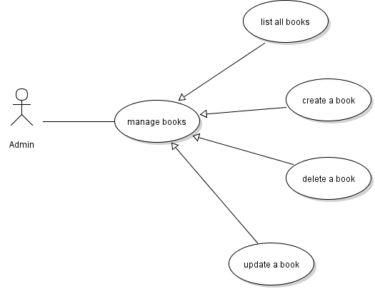
Book Management Use Cases

Slide 3
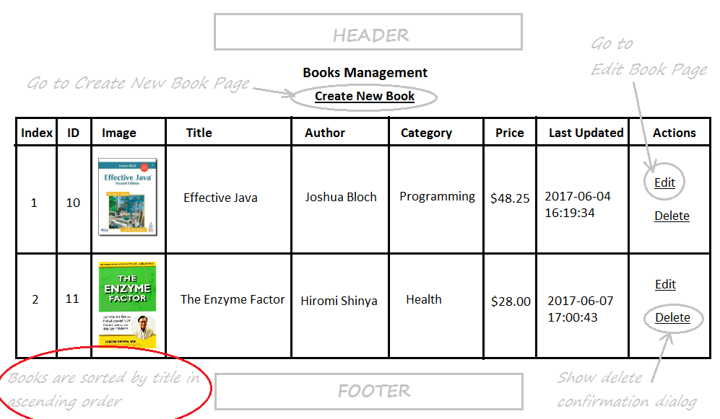
Books List Page

Slide 4
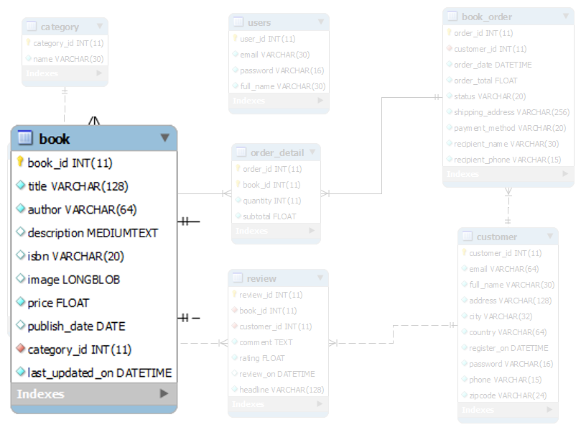
Database Design – Table book

Slide 5
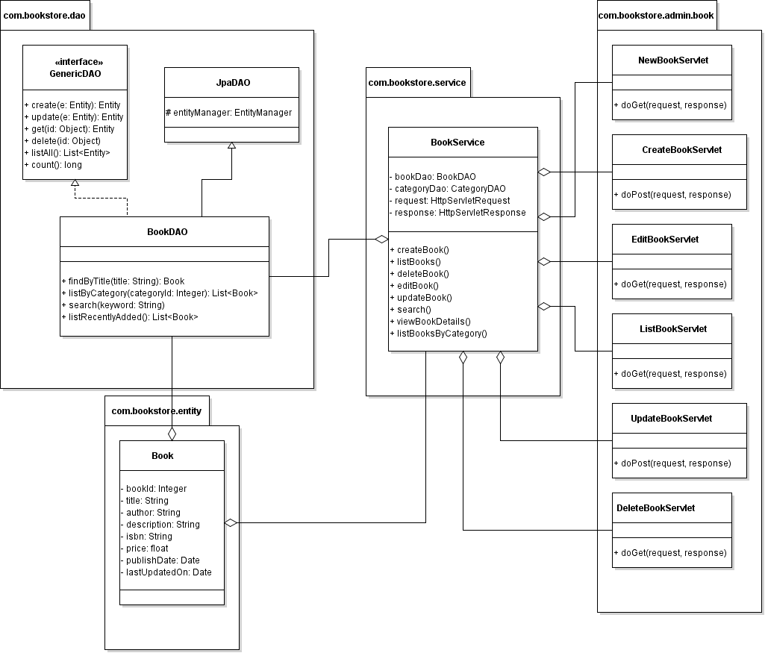
Class Diagram

Slide 6
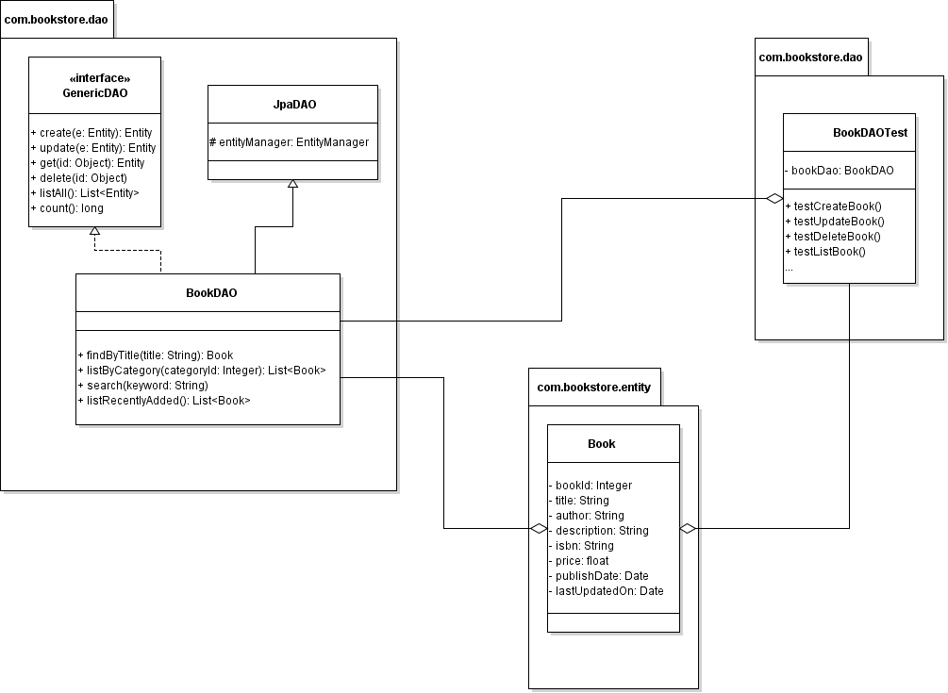
Code BookDAO

Slide 7
Implement List Books feature
Code ListBookServlet
Update BookServices
Code Book List Page (HTML + JSTL)

Slide 8
Books List Page

Slide 9
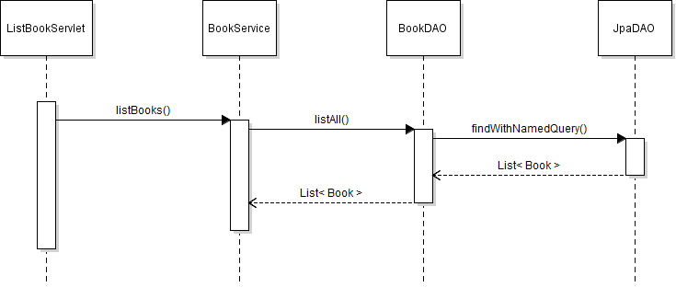
List Books Sequence Diagram

Slide 10
Implement Create Book Feature
Code Book Form Page (JSP)
Code NewBookServlet
Validate Input in Book Form (Javascript)
Code CreateBookServlet
Code BookServices Class

Slide 11
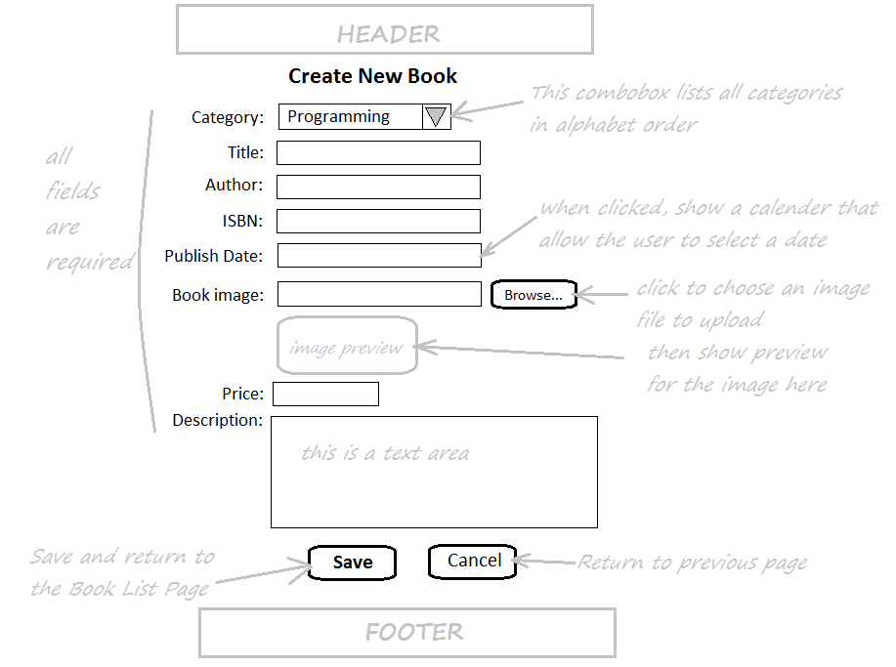
Book Form Page

Slide 12

Activity Diagram: New Book

Slide 13
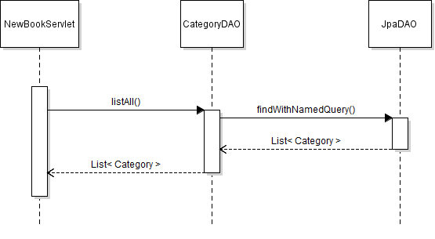
Sequence Diagram: New Book

Slide 14
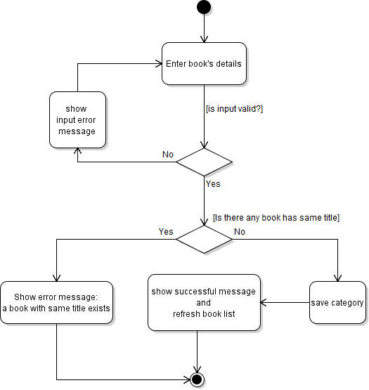
Activity Diagram: Create Book

Slide 15
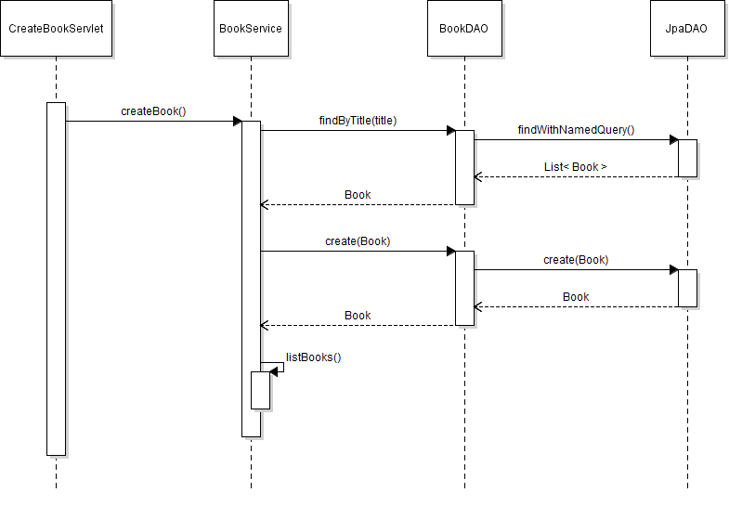
Sequence Diagram: Create Book

Slide 16
Implement Edit Book Feature
Create EditBookServlet Class
Update Book Form Page (JSP)
Create UpdateBookServlet
Update BookServices Class

Slide 17
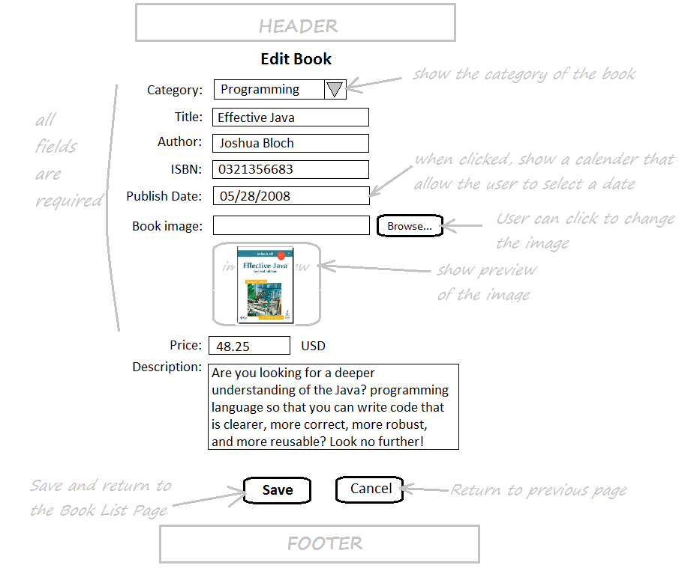
Book Form in Edit mode

Slide 18
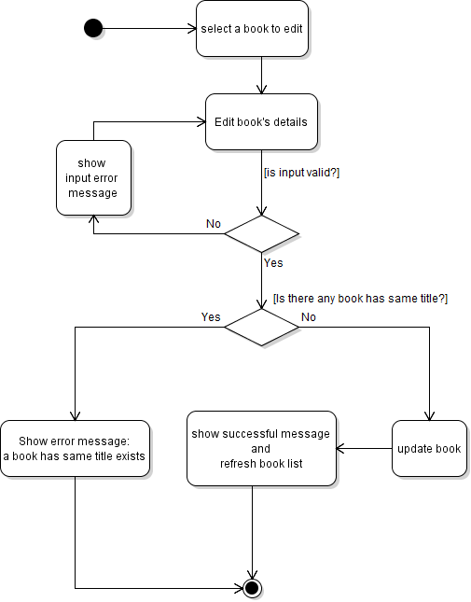
Activity Diagram: Update Book

Slide 19
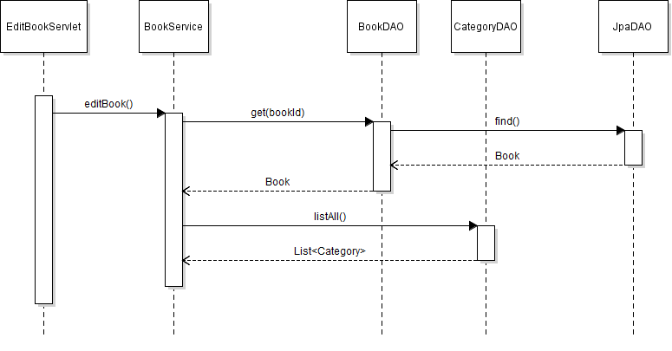
Sequence Diagram: Edit Book

Slide 20
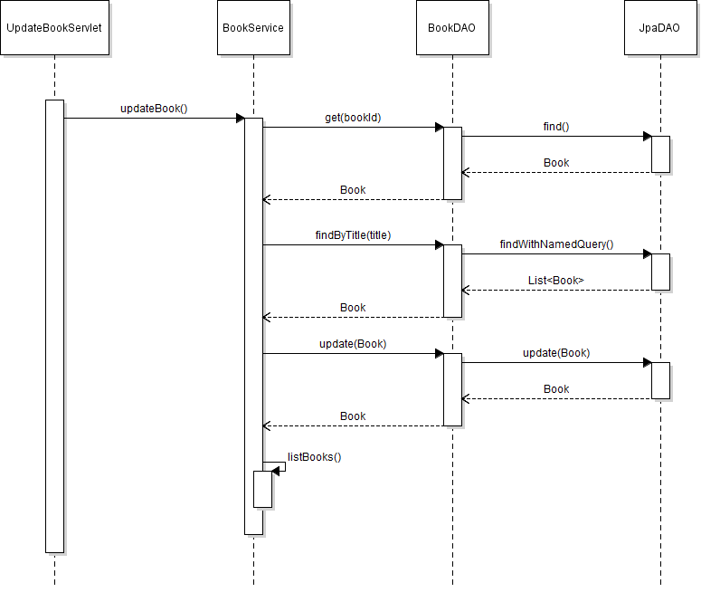
Sequence Diagram: Update Book

Slide 21
Implement Delete Book Feature
Show Delete Confirmation Dialog
Create DeleteBookServlet
Update BookServices Class
Code OrderDAO Class
Code ReviewDAO Class

Slide 22
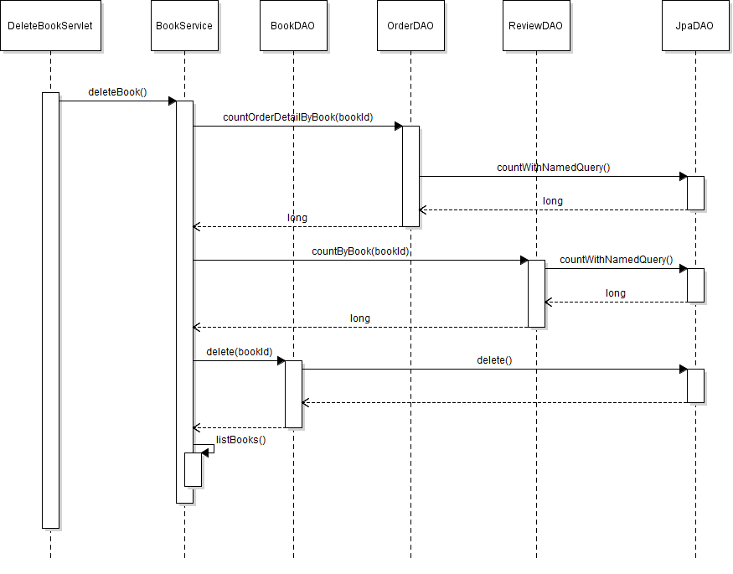
Sequence Diagram: Delete Book

Slide 23
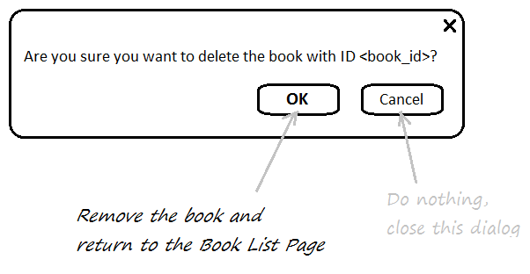
Delete Book Confirmation Dialog

Slide 24
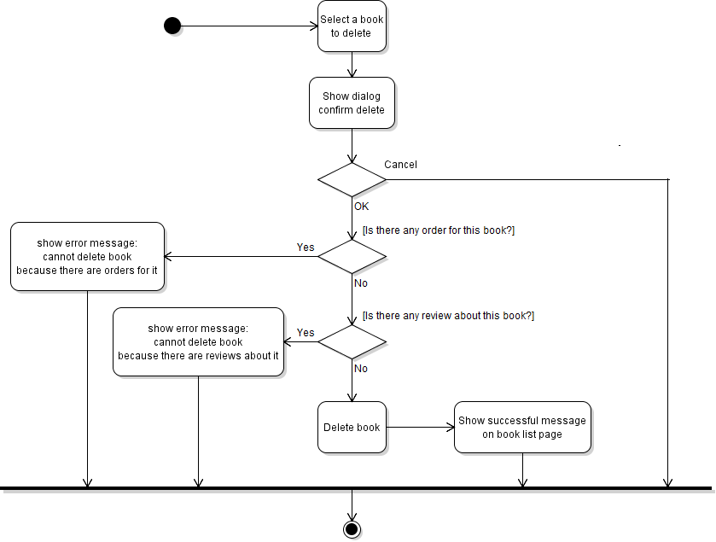
Activity Diagram: Delete Book

